Slide 1
Introduction to Similarity-based Learning
National Chung Hsing University
Department of Computer Science and Engineering
Yao-Chung Fan
yfan@nchu.edu.tw

Slide 2
Basic Idea Review: Similarity-based Learning
Similarity-based prediction models attempt to mimic a very human way of reasoning by basing predictions for a target feature value on the most similar instances in memory—this makes them easy to interpret and understand.
One of the simplest and best known machine learning algorithms for this type of reasoning is called the nearest neighbor algorithm.

Slide 3
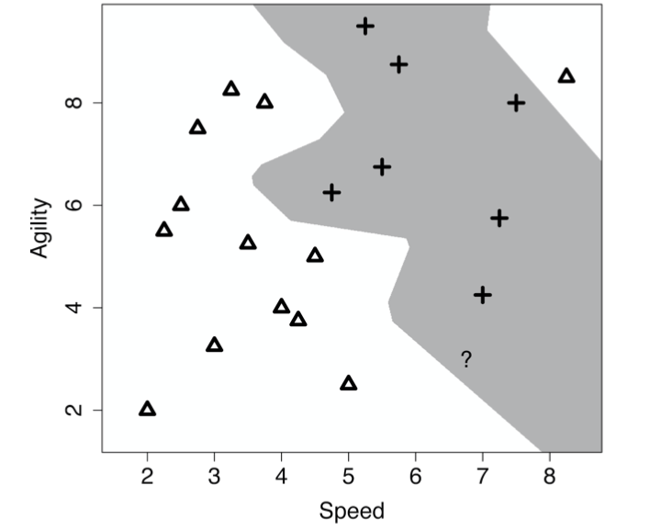
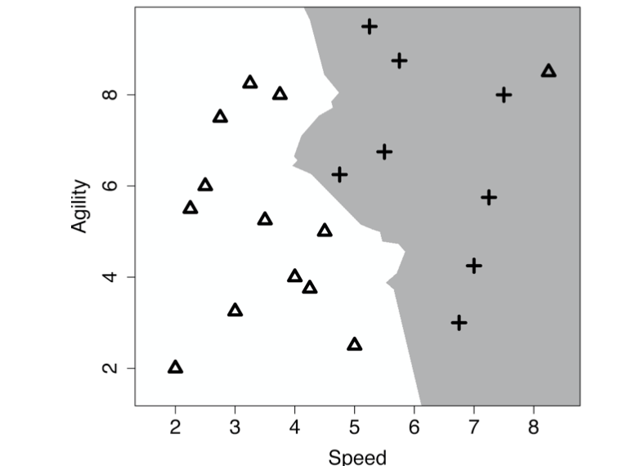
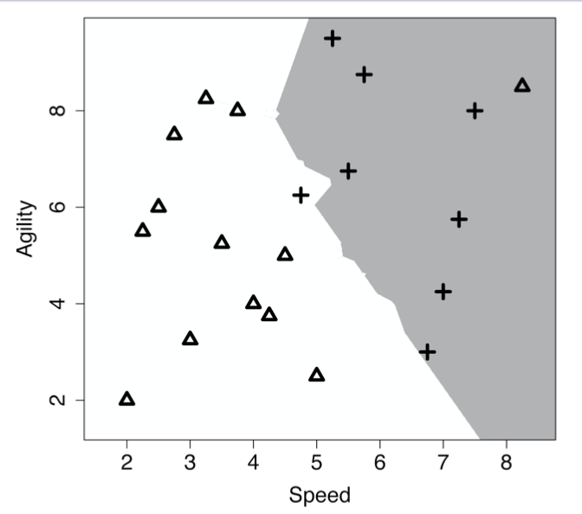
k nearest neighbors
The k nearest neighbors model predicts the target level with the majority vote from the set of k nearest neightbors to the query q
k=1
k=3
k=5

Slide 4
A very fundamental step for all data mining techniques:
Finding similar items

Slide 5
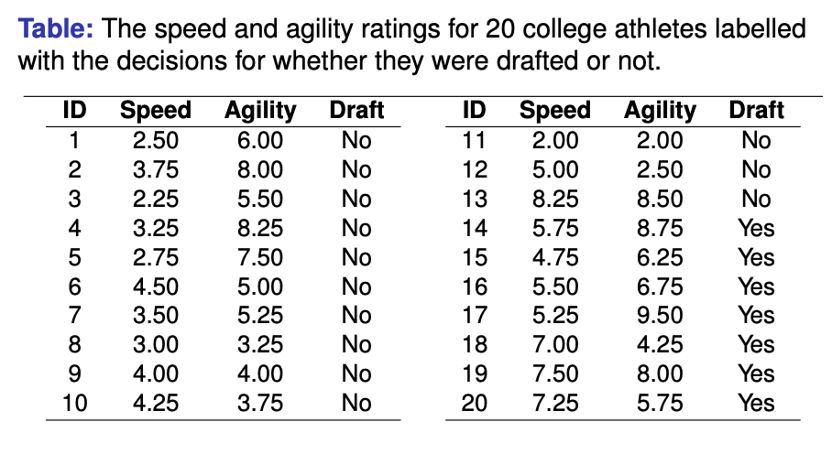
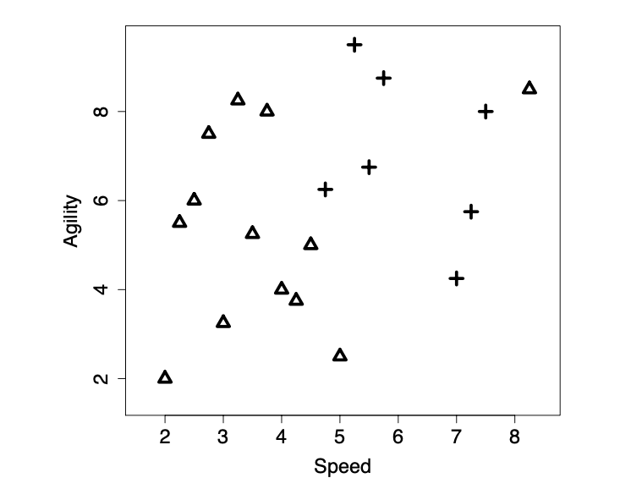
Fundamentals behind Similarity-based Learning
The fundamentals of similarity-based learning are:
Feature space: A feature space is an abstract n-dimensional space that is created by taking each of the descriptive features to be the axes of a reference space and each instance in the dataset is mapped to a point in the feature space based on the values of its descriptive features.
Similarity metrics: A similarity metric measures the similarity between two instances according to a feature space

Slide 6
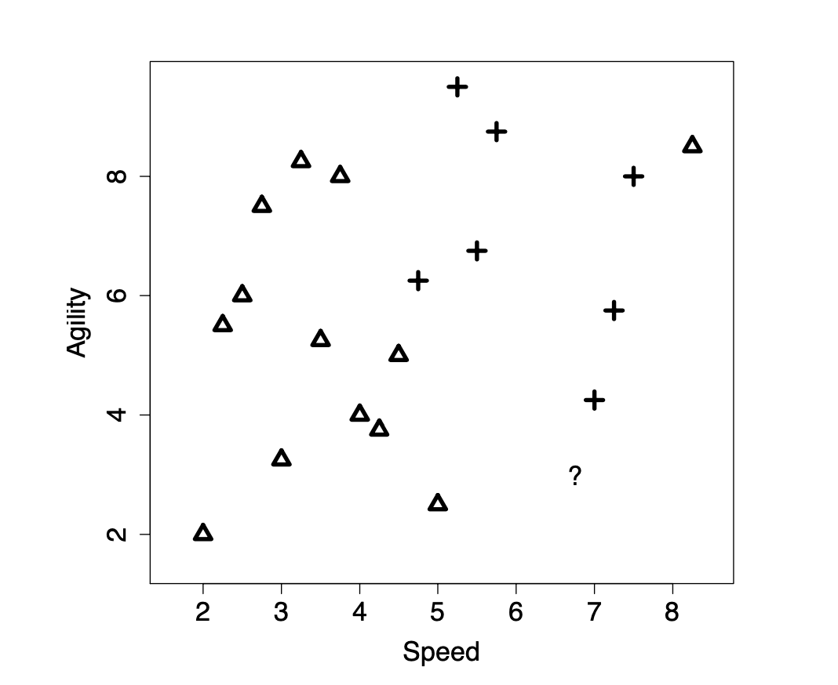
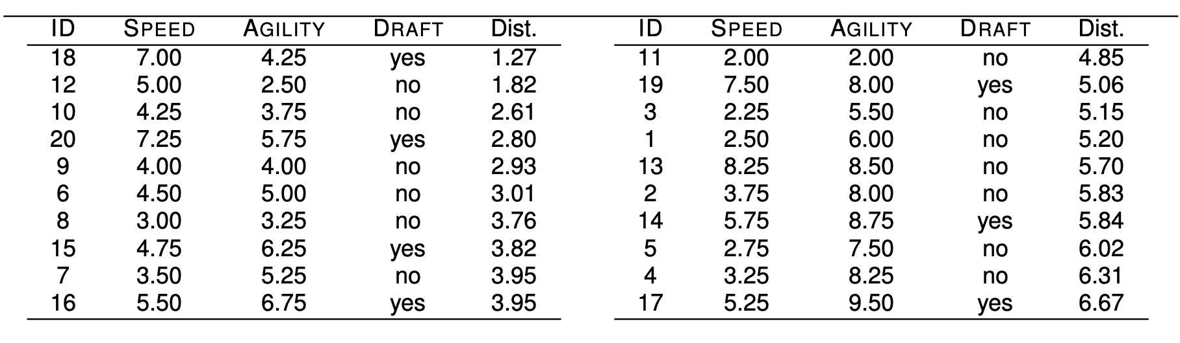
The Nearest Neighbor Algorithm Example
Should we draft an athlete with the following profile:
< SPEED= 6.75, AGILITY= 3 > ?

Slide 7
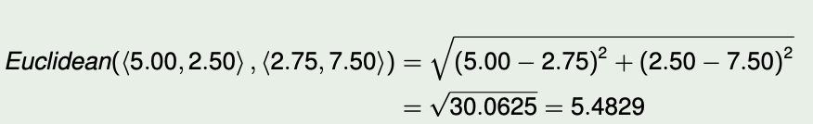
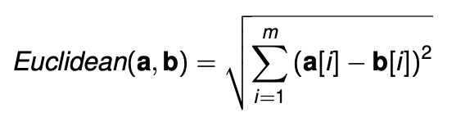
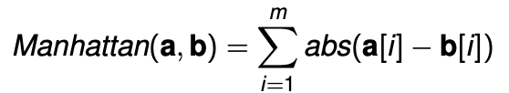
Similarity Measures (1/2)
One of the best known metrics is Euclidean distance which computes the length of the straight line between two points. Euclidean distance between two instances a and b in a m-dimensional feature space is defined as:
Another, less well known, distance measure is the Manhattan distance or taxi-cab distance. The Manhattan distance between two instances a and b in a feature space with m dimensions is
d₁₂ d₅
e.g.
d₁₂ d₅
e.g.
Manhattan(⟨5.00, 2.50⟩ , ⟨2.75, 7.50⟩) =
abs(5.00 − 2.75) + abs(2.5 − 7.5) = 2.25+5 = 7.25

Slide 8
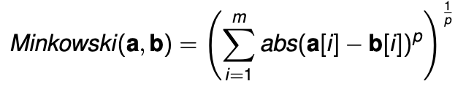
Similarity Measures (2/2)
The Euclidean and Manhattan distances are special cases of Minkowski distance
The Minkowski distance between two instances a and b in a feature space with m descriptive features is:
The Minkowski distance with p = 1 is the Manhattan distance and with p = 2 is the Euclidean distance.

Slide 9
The Nearest Neighbor Algorithm
Require: set of training instances
Require: a query/instance to be classified
1: Iterate across the instances in memory and find the instance that is shortest distance from the query position in the feature space.
2: Make a prediction for the query equal to the value of the target feature of the nearest neighbor.

Slide 10
Data Normalization

Slide 11
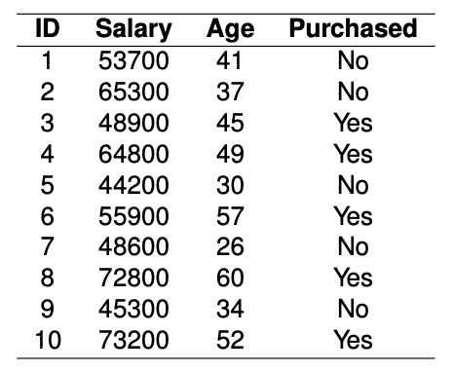
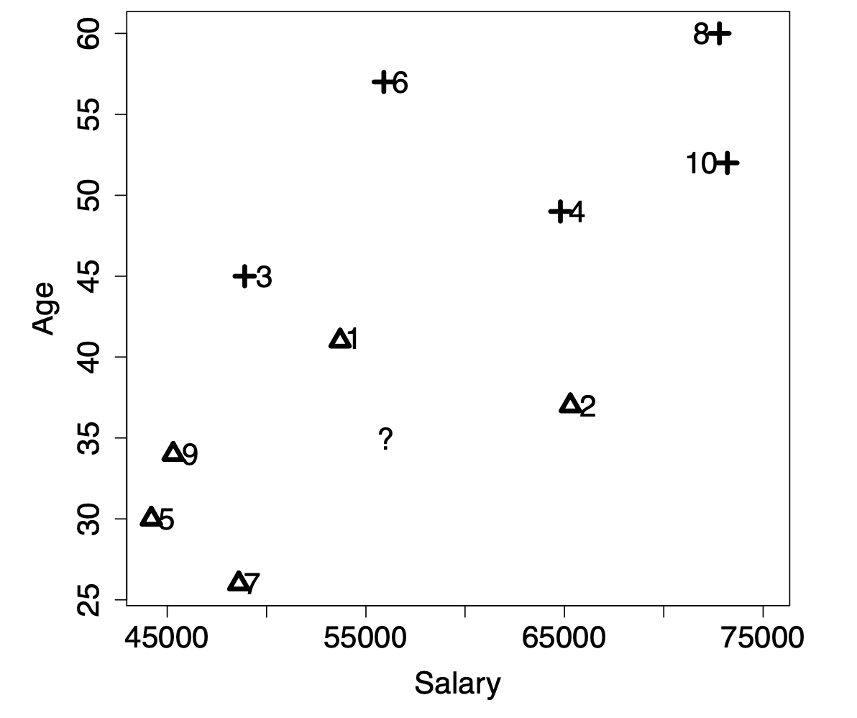
Data Normalization
The marketing department wants to decide whether or not they should contact a customer with the following profile:
⟨SALARY = 56, 000, AGE = 35⟩

Slide 12
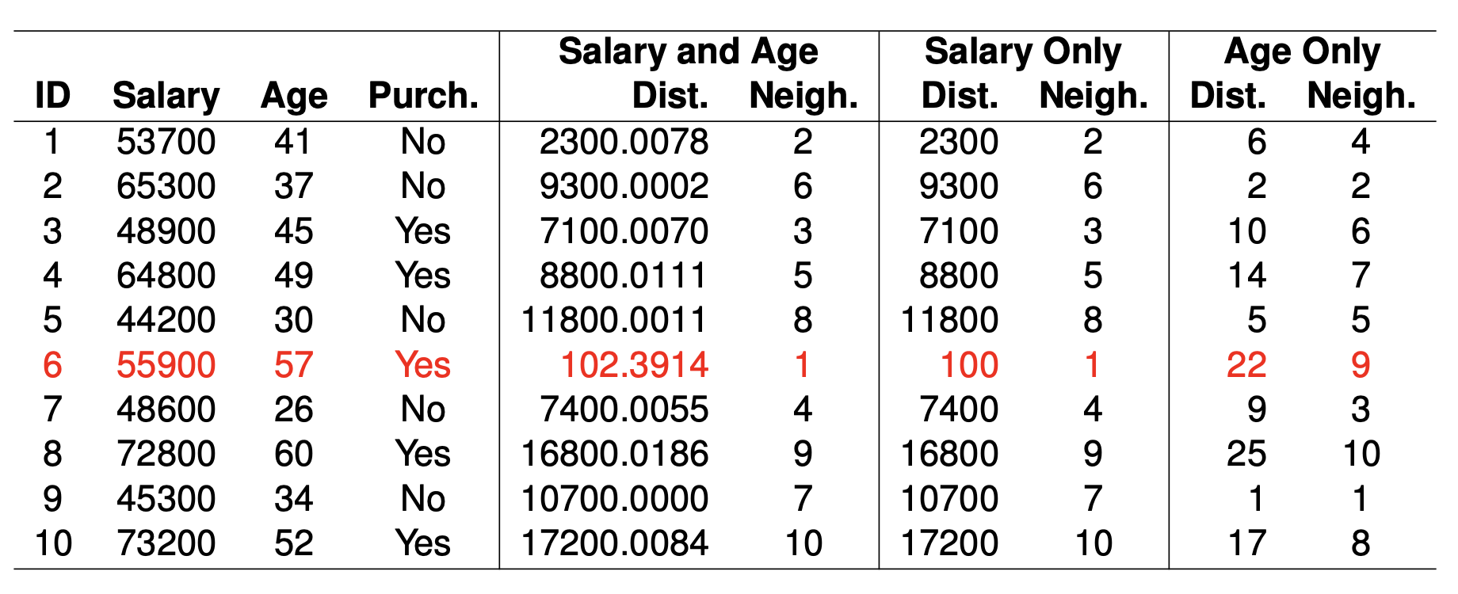
Data Normalization
⟨SALARY = 56000, AGE = 35⟩

Slide 13
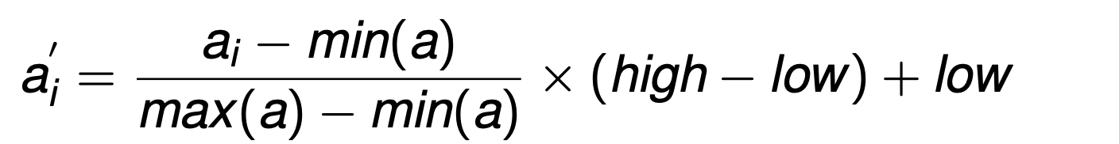
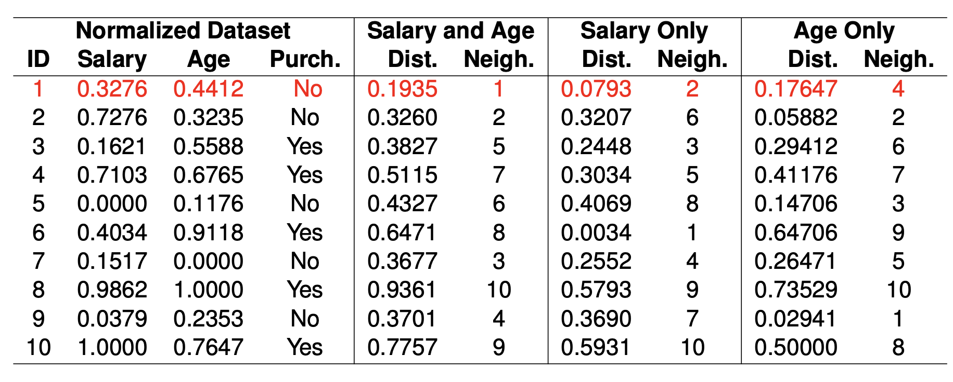

Data Normalization
This odd prediction is caused by features taking different ranges of values, this is equivalent to features having different variances.
We can adjust for this using normalization; the equation for range normalization is:
ref
⟨SALARY = 56000, AGE = 35⟩
⟨SALARY = 0.4068, AGE = 0.2647⟩

Slide 14
Handling Categorical Attributes

Slide 15
Categorical Attribute Example
Example: A binary dataset listing the behavior of two individuals on a website during a trial period and whether or not they subsequently signed-up for the website.
ID | Profile | FAQ | HelpForum | Newsletter | Liked | Signup
1 | 1 | 1 | 1 | 0 | 1 | Yes
2 | 1 | 0 | 0 | 0 | 0 | No
q | 1 | 0 | 1 | 0 | 0 | ?

Slide 16
Categorical Attribute Example
The similarity between the current trial user, q, and the two users in the dataset, d₁ and d₂, in terms of co-presence (CP), co-absence (CA), presence-absence (PA), and absence-presence (AP).
ID | Profile | FAQ | HelpForum | Newsletter | Liked | Signup
d₁ | 1 | 1 | 1 | 0 | 1 | Yes
d₂ | 1 | 0 | 0 | 0 | 0 | No
q | 1 | 0 | 1 | 0 | 0 | ?
q
q
 | Pres. | Abs.
Pres. | CP=2 | PA=2
Abs. | AP=0 | CA=1
 | Pres. | Abs.
Pres. | CP=1 | PA=0
Abs. | AP=1 | CA=3
d₁
d₂

Slide 17
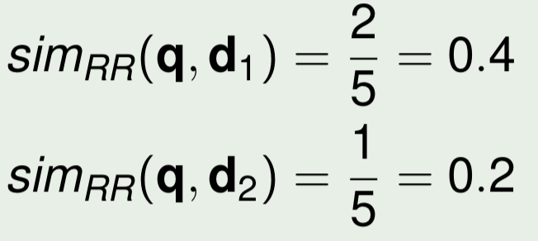
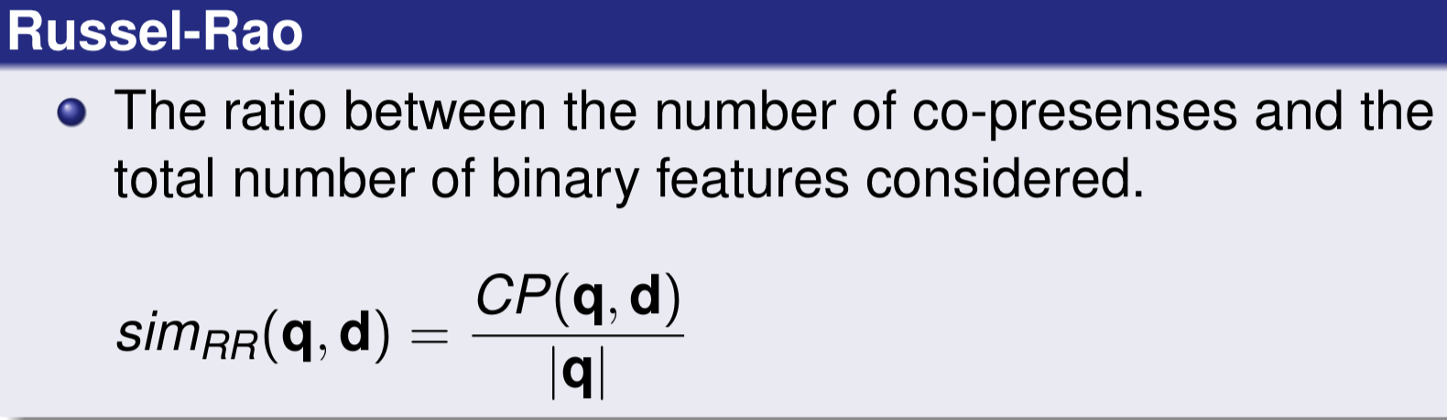
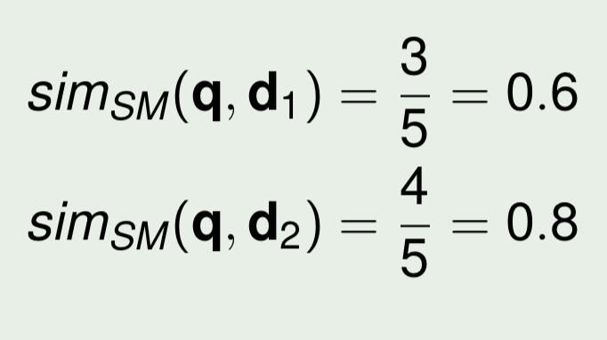
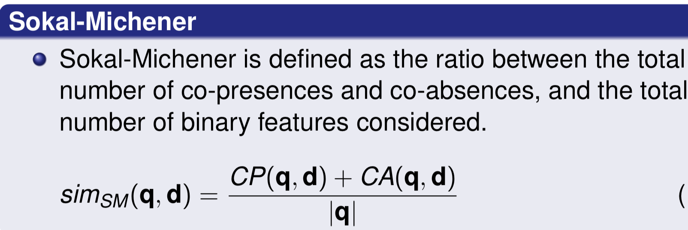
Common Similarity Measure (1/2)
q
q
 | Pres. | Abs.
Pres. | CP=2 | PA=2
Abs. | AP=0 | CA=1
 | Pres. | Abs.
Pres. | CP=1 | PA=0
Abs. | AP=1 | CA=3
d₁
d₂
Russel-Rao
Sokai-Michener

Slide 18
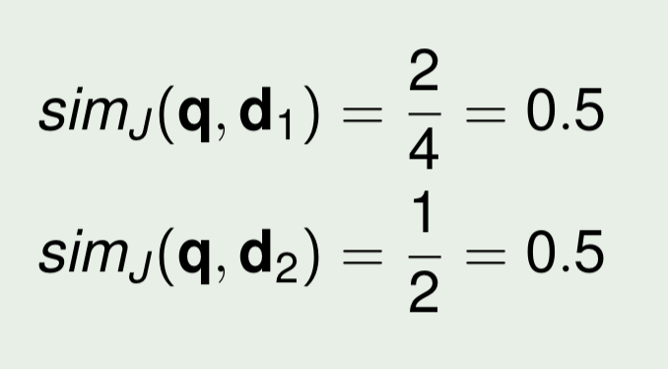
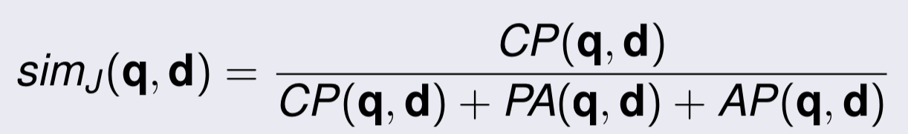
Common Similarity Measure (2/2)
q
q
 | Pres. | Abs.
Pres. | CP=2 | PA=2
Abs. | AP=0 | CA=1
 | Pres. | Abs.
Pres. | CP=1 | PA=0
Abs. | AP=1 | CA=3
d₁
d₂
Jaccard

Slide 19
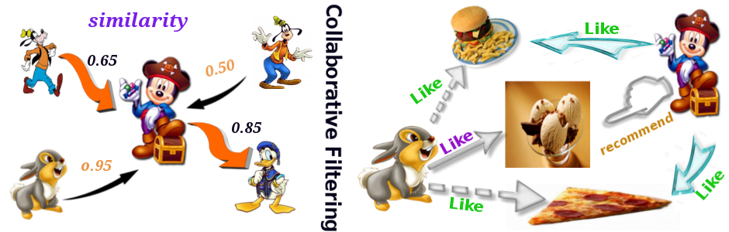
The most profitable algorithm in history?
Recommendation System

Slide 20





Slide 21




Item Recommender
or

Slide 22
Machine Learning and Personalization
Machine Learning can learn a user model of a particular user based on:
Sample interaction
Rated examples
This model can then be used to:
Recommend items
Filter information
Predict behavior

Slide 23

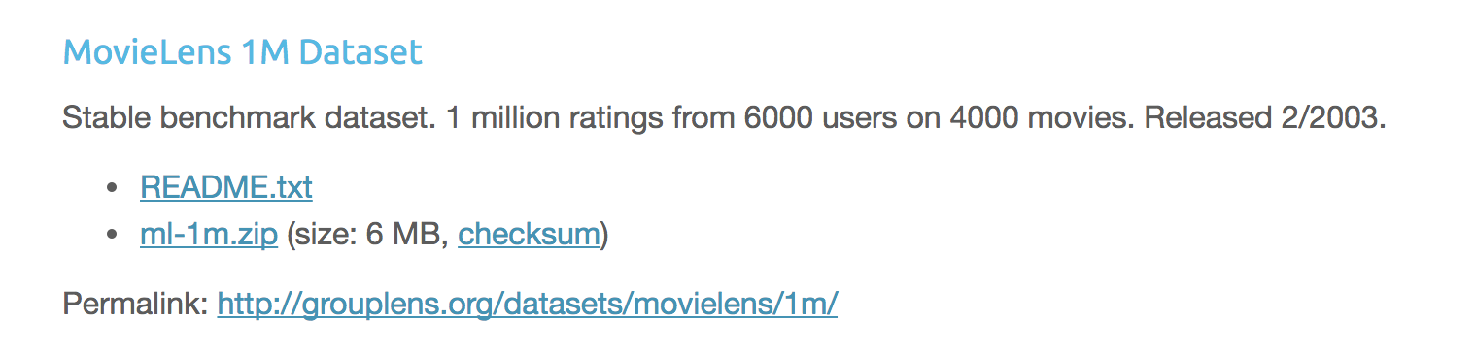
Assignment
為我推薦個電影吧？
我預先勾好幾部我喜歡的電影，以及其評價。
Please Predict the following movie’s rating for me
Dataset: https://grouplens.org/datasets/movielens/

Slide 24
My Rating for the Following Movies
1::Toy Story (1995)::Animation|Children's|Comedy, 5
2::Jumanji (1995)::Adventure|Children's|Fantasy, 4
9::Sudden Death (1995)::Action, 2
10::GoldenEye (1995)::Action|Adventure|Thriller, 2
13::Balto (1995)::Animation|Children's, 1
14::Nixon (1995)::Drama, 1
17::Sense and Sensibility (1995)::Drama|Romance, 1
22::Copycat (1995)::Crime|Drama|Thriller, 2
23::Assassins (1995)::Thriller, 3
47::Seven (Se7en) (1995)::Crime|Thriller, 2
356::Forrest Gump (1994)::Comedy|Romance|War, 5
3147::Green Mile, The (1999)::Drama|Thriller, 5
593::Silence of the Lambs, The (1991)::Drama|Thriller, 2
2028::Saving Private Ryan (1998)::Action|Drama|War, 5
838::Emma (1996)::Comedy|Drama|Romance, 1
1721::Titanic (1997)::Drama|Romance, 5
2628::Star Wars: Episode I - The Phantom Menace (1999)::Action|Adventure|Fantasy|Sci-Fi, 4
1608::Air Force One (1997)::Action|Thriller, 4
165::Die Hard: With a Vengeance (1995)::Action|Thriller, 4
589::Terminator 2: Judgment Day (1991)::Action|Sci-Fi|Thriller, 2
318::Shawshank Redemption, The (1994)::Drama, ?
527::Schindler's List (1993)::Drama|War, ?
2959::Fight Club (1999)::Drama, ?
393::Street Fighter (1994)::Action, ?
3285::Beach, The (2000)::Adventure|Drama, ?
2571::Matrix, The (1999)::Action|Sci-Fi|Thriller, ?
1270::Back to the Future (1985)::Comedy|Sci-Fi, ?
3578::Gladiator (2000)::Action|Drama, ?
1200::Aliens (1986)::Action|Sci-Fi|Thriller|War, ?
2858::American Beauty (1999)::Comedy|Drama, ?

Slide 25

Amazon.com

Slide 26
Application Scenario
Many items
Many ratings
Many more users than items recommended
Users rate multiple items
For each user of the community, there are other users with common needs or tastes
Item evaluation requires personal taste
Items persists
Taste persists
Items are homogenous

Slide 27

Movie Recommendation Example with the following user’s preference log
 | Lady in the Water | Snakes on a Plane | Just My Luck | Superman Returns | You, Me and Dupree | The Night Listener
Rose | 2.5 | 3.5 | 3.0 | 3.5 | 2.5 | 3.0
Seymour | 3.0 | 3.5 | 1.5 | 5 | 3.5 | 3.0
Phillips | 2.5 | 3.0 |  | 3.5 |  | 4.0
Puig |  | 3.5 | 3.0 | 4.0 | 2.5 | 4.5
LaSalle | 3.0 | 4.0 | 2.0 | 3.0 | 2.0 | 3.0
Matthews | 3.0 | 4.0 |  | 5.0 | 3.5 | 3.0
Toby |  | 4.5 |  | 4.0 | 1.0
?
?
?

Slide 28
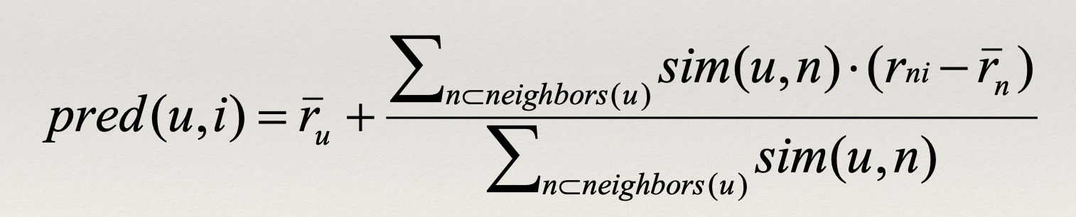
Algorithms : K-Nearest Neighbors
User-Based Nearest Neighbor
Neighbor = similar users
Generate a prediction for an item i by analyzing ratings for i from users in u’s neighborhood

Slide 29
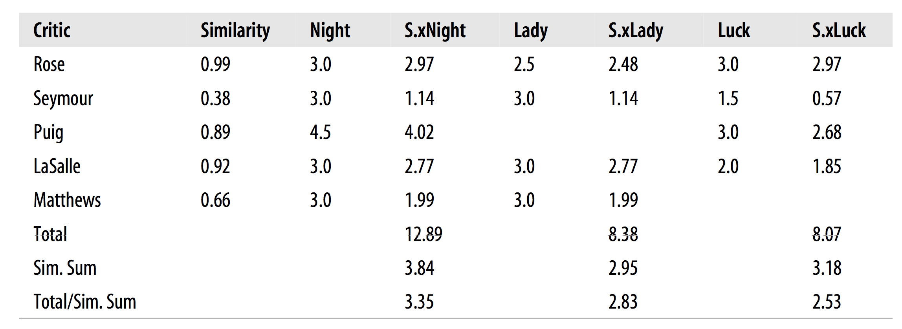
Algorithm: Find similar users of Toby and use their ratings to predict rating for Toby Toby
The Night Listener
Lady in the Water
Just My Luck

Slide 30
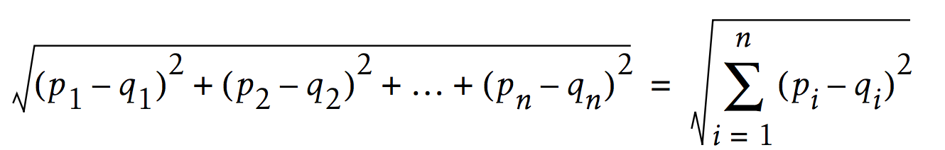
Similarity? Euclidean Distance ?
Euclidean Distance
 | Lady in the Water | Snakes on a Plane | Just My Luck | Superman Returns | You, Me and Dupree | The Night Listener
Rose | 2.5 | 3.5 | 3.0 | 3.5 | 2.5 | 3.0
Seymour | 3.0 | 3.5 | 1.5 | 5 | 3.5 | 3.0
Phillips | 2.5 | 3.0 |  | 3.5 |  | 4.0
Puig |  | 3.5 | 3.0 | 4.0 | 2.5 | 4.5
LaSalle | 3.0 | 4.0 | 2.0 | 3.0 | 2.0 | 3.0
Matthews | 3.0 | 4.0 |  | 5.0 | 3.5 | 3.0
Toby |  | 4.5 |  | 4.0 | 1.0

Slide 31
Pearson Correlation as a Similarity Measure

Slide 32
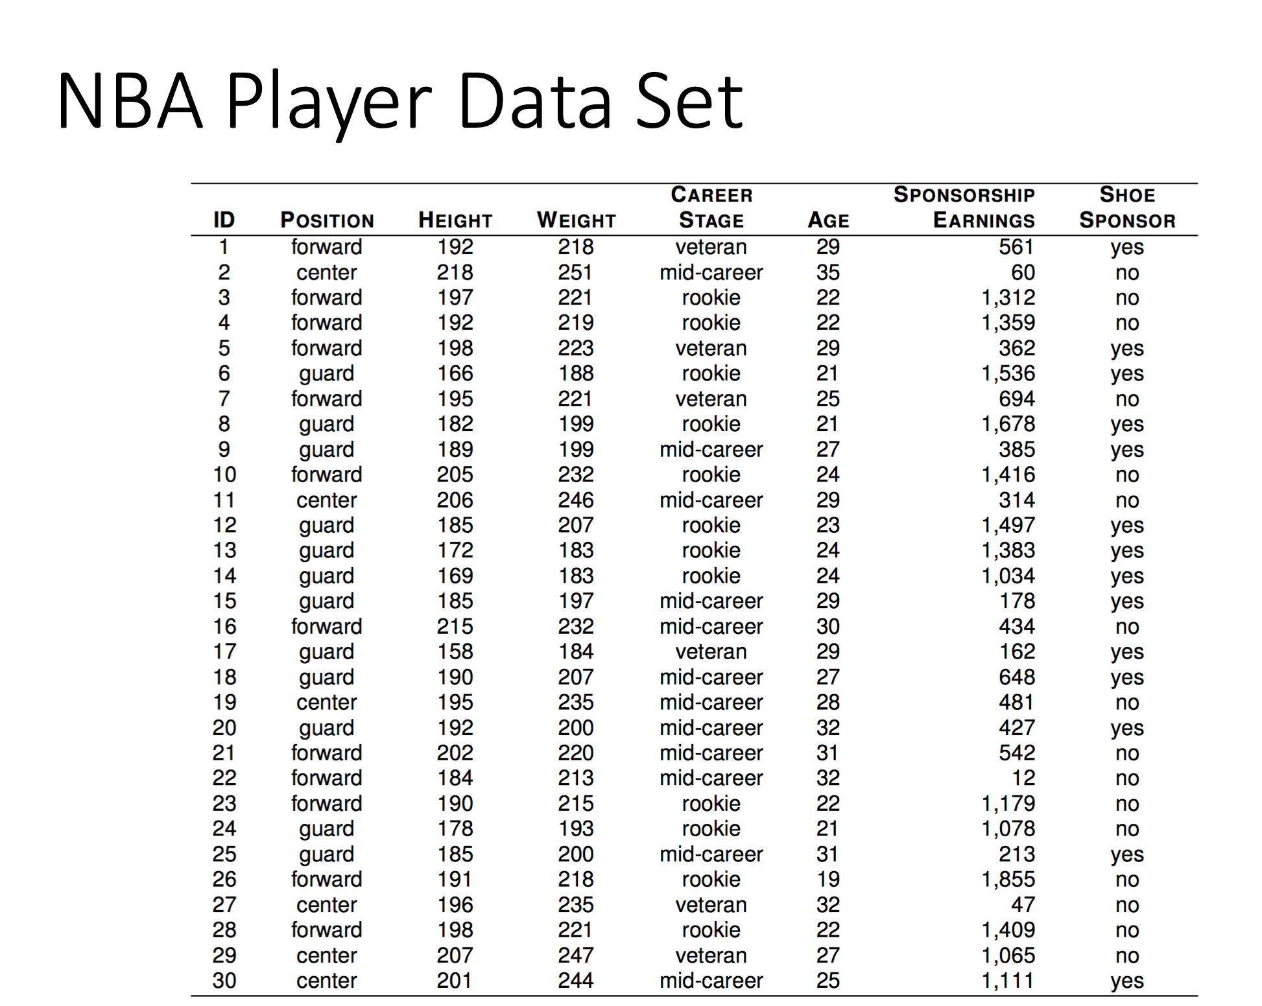

Slide 33
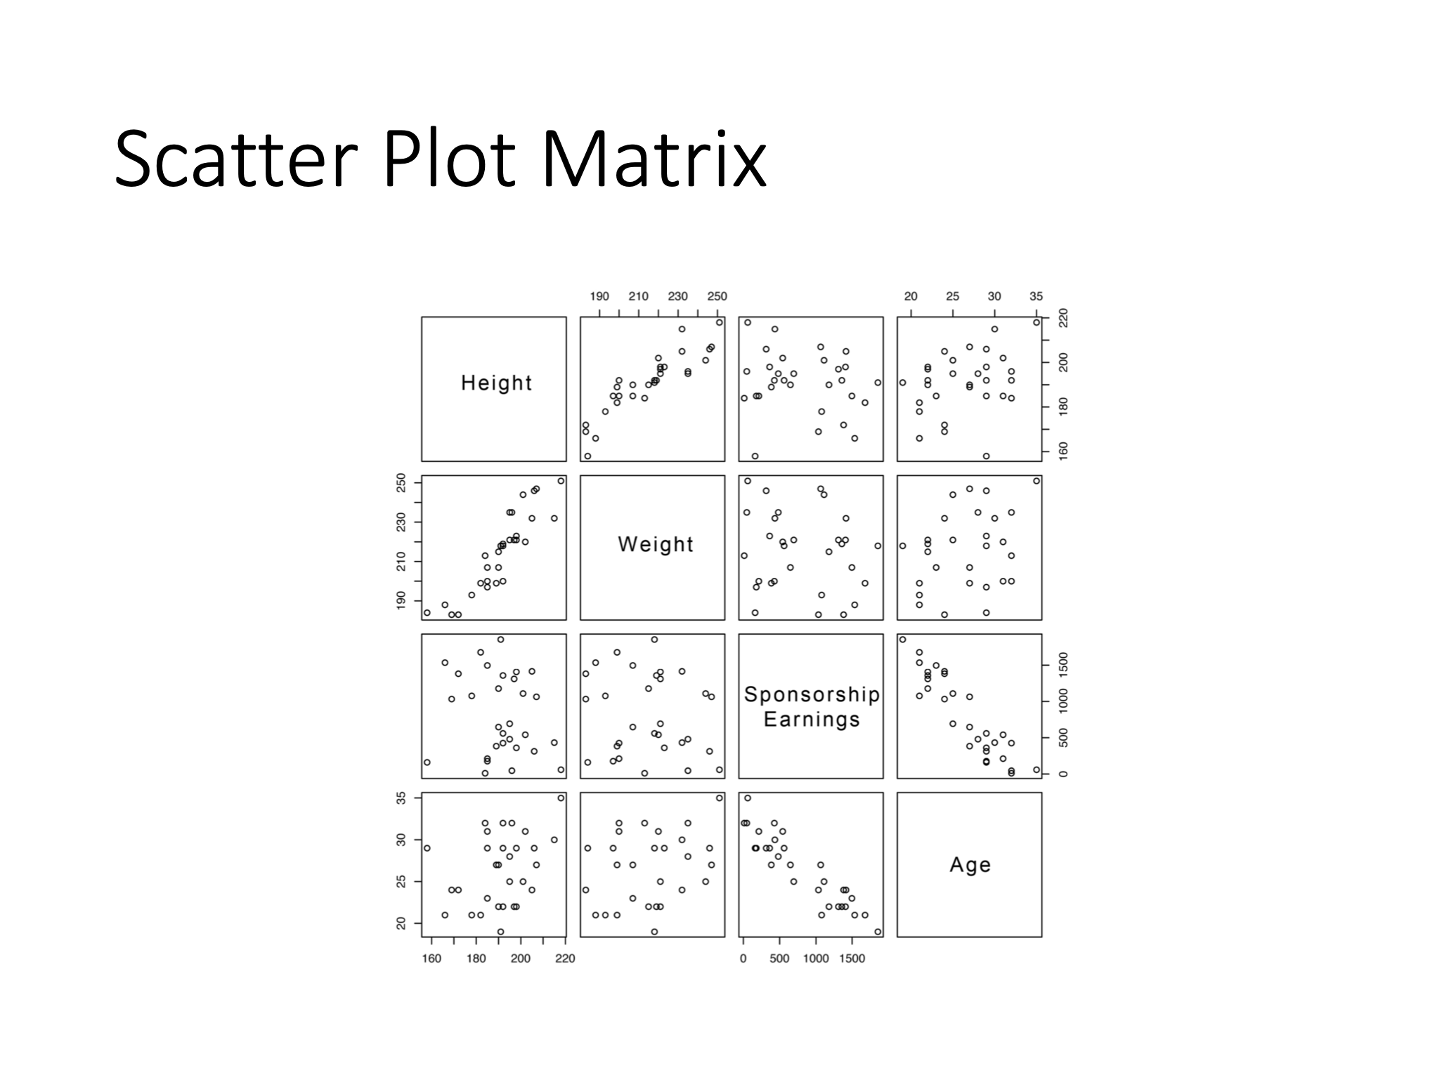
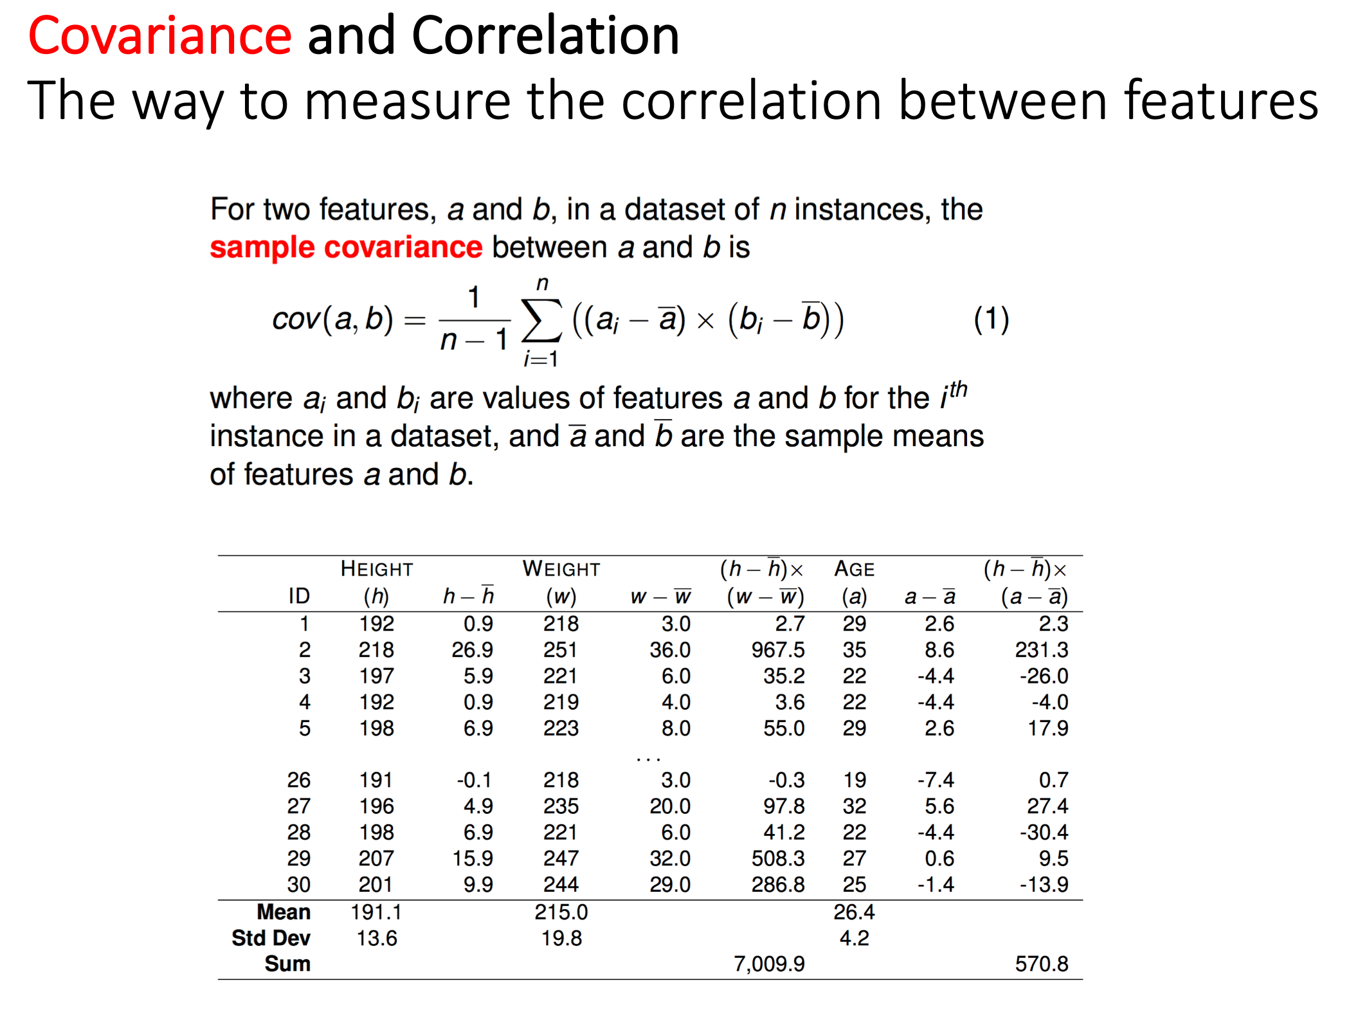
Covariance and Correlation (1/4)
Scatter Plot Matrix
The way to measure the correlation between features

Slide 34
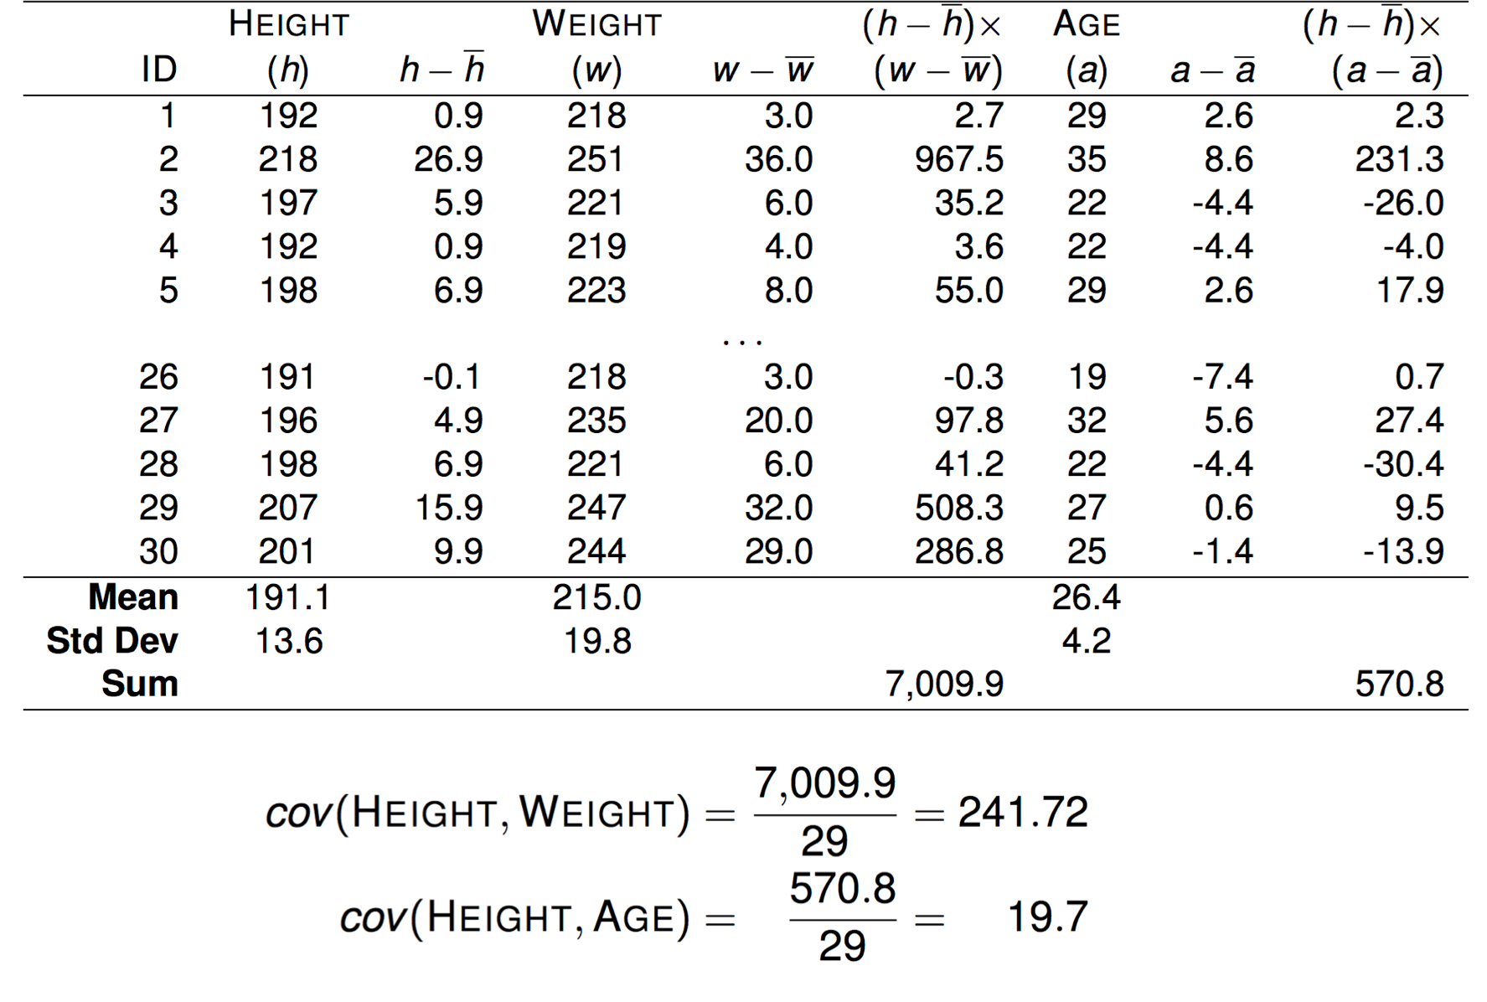
Covariance and Correlation (2/4)

Slide 35
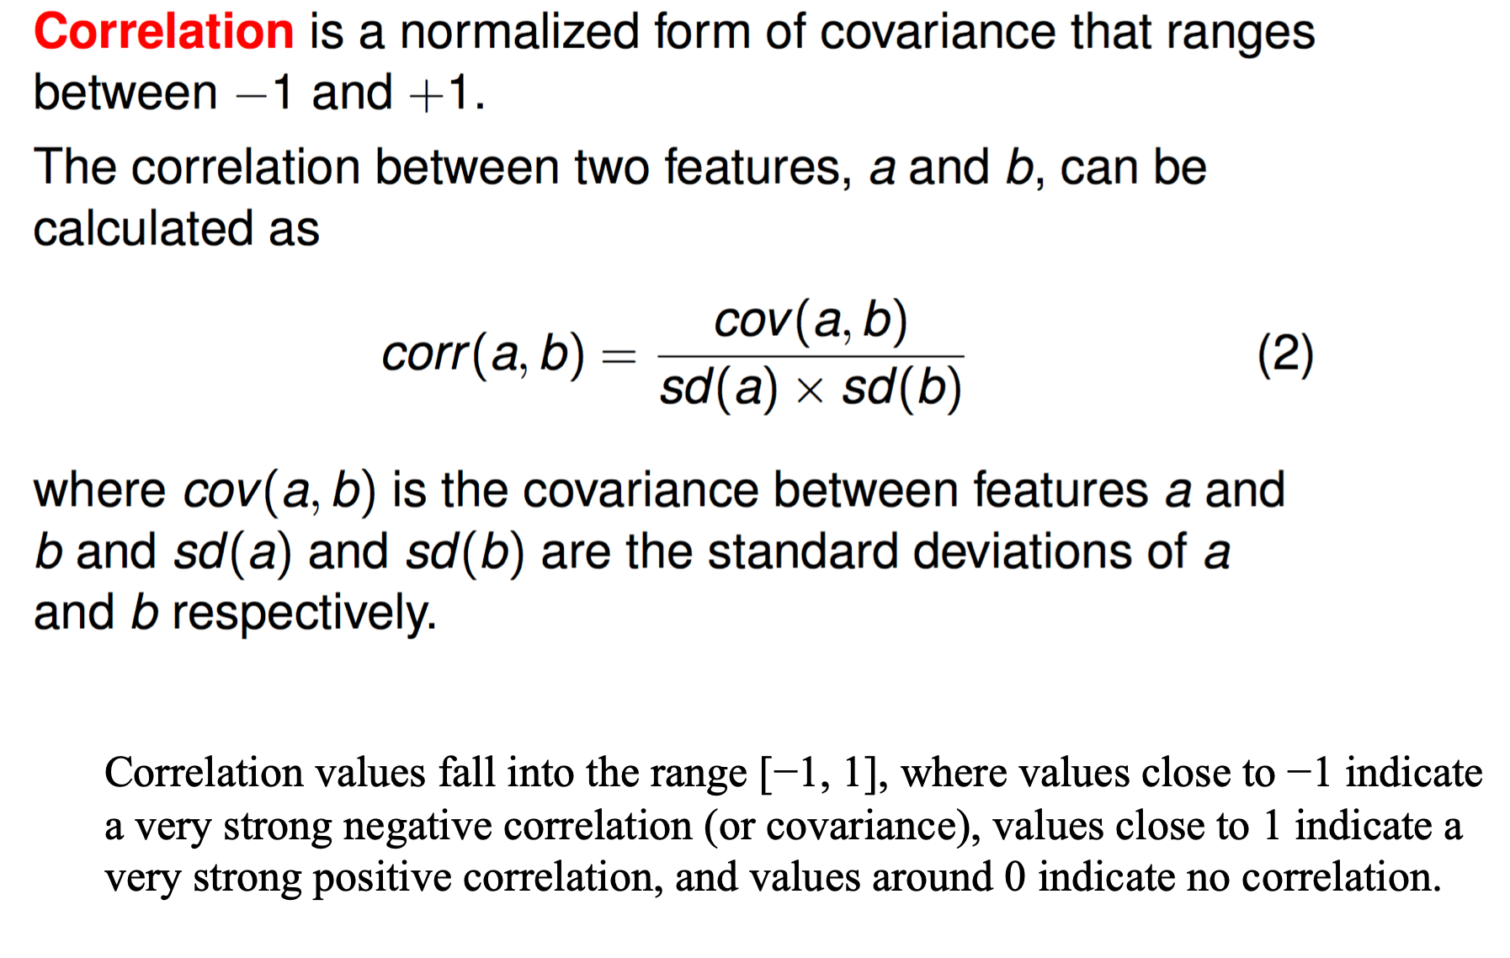
Covariance and Correlation (3/4)

Slide 36
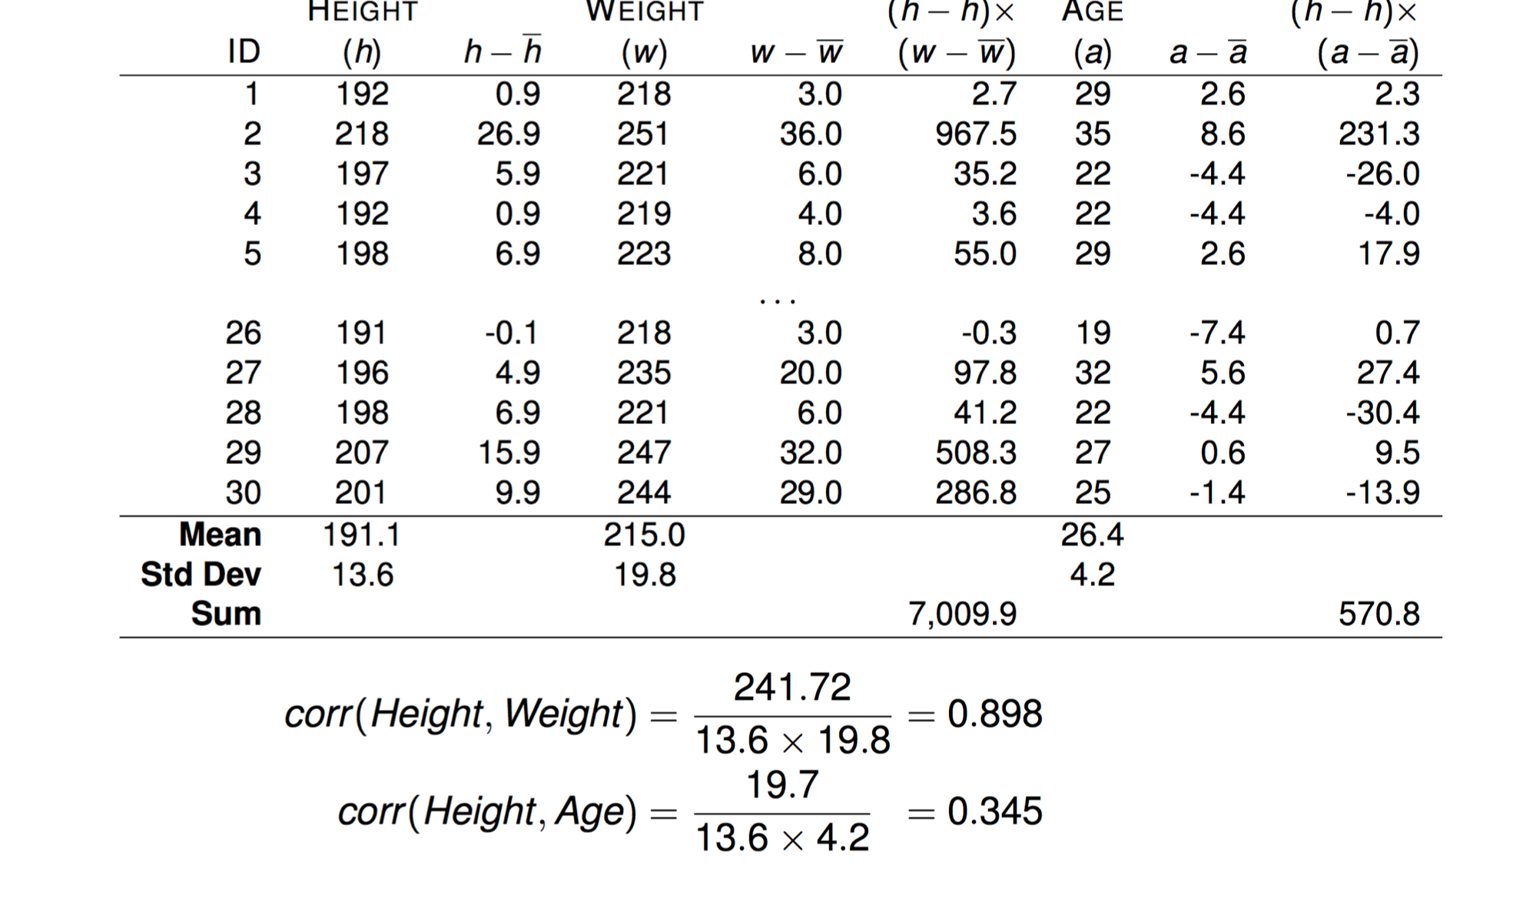
Covariance and Correlation (4/4)

Slide 37
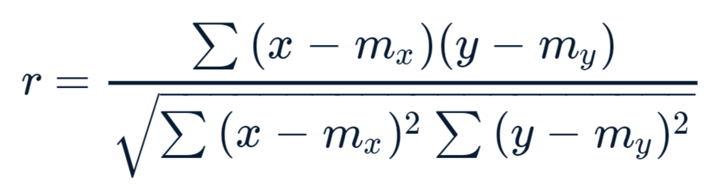
Pearson Correlation
Pearson Distance
 | Lady in the Water | Snakes on a Plane | Just My Luck | Superman Returns | You, Me and Dupree | The Night Listener
Rose | 2.5 | 3.5 | 3.0 | 3.5 | 2.5 | 3.0
Seymour | 3.0 | 3.5 | 1.5 | 5 | 3.5 | 3.0
Phillips | 2.5 | 3.0 |  | 3.5 |  | 4.0
Puig |  | 3.5 | 3.0 | 4.0 | 2.5 | 4.5
LaSalle | 3.0 | 4.0 | 2.0 | 3.0 | 2.0 | 3.0
Matthews | 3.0 | 4.0 |  | 5.0 | 3.5 | 3.0
Toby |  | 4.5 |  | 4.0 | 1.0

Slide 38
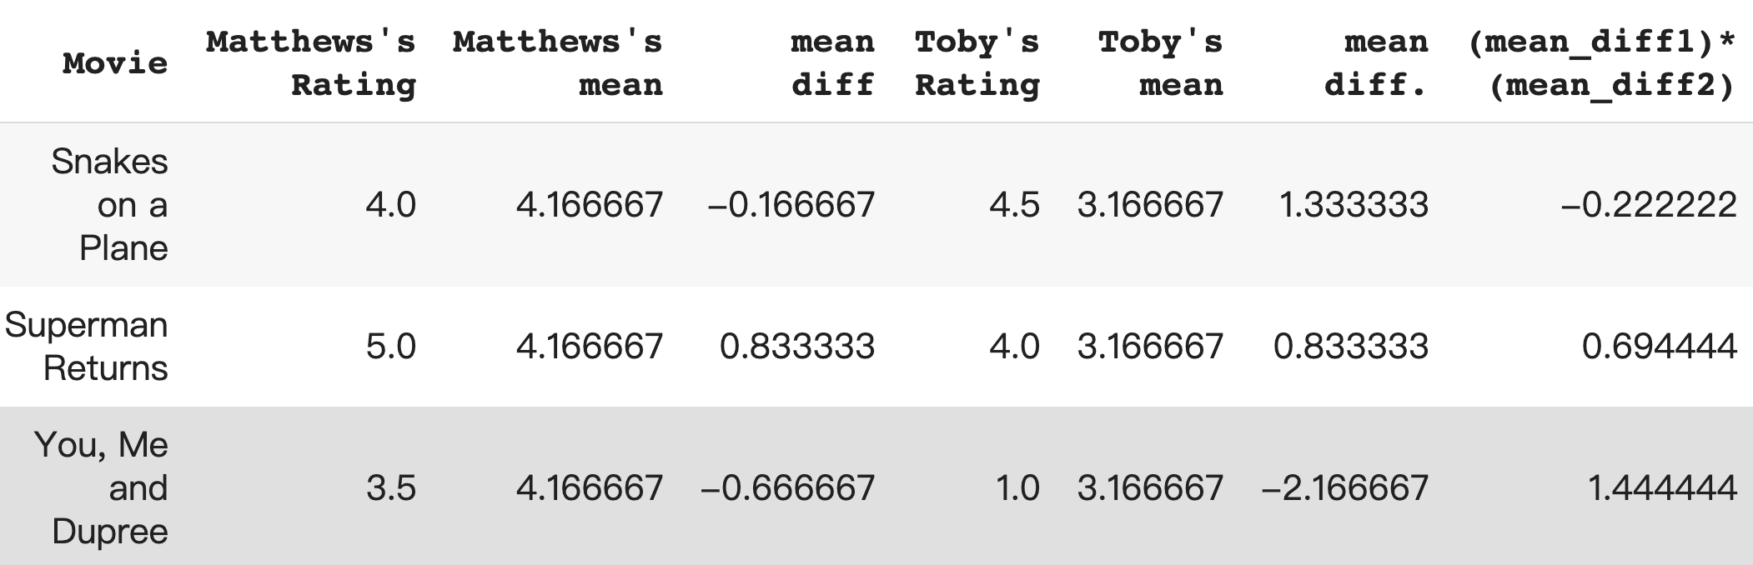
Running Example
r=0.68

Slide 39
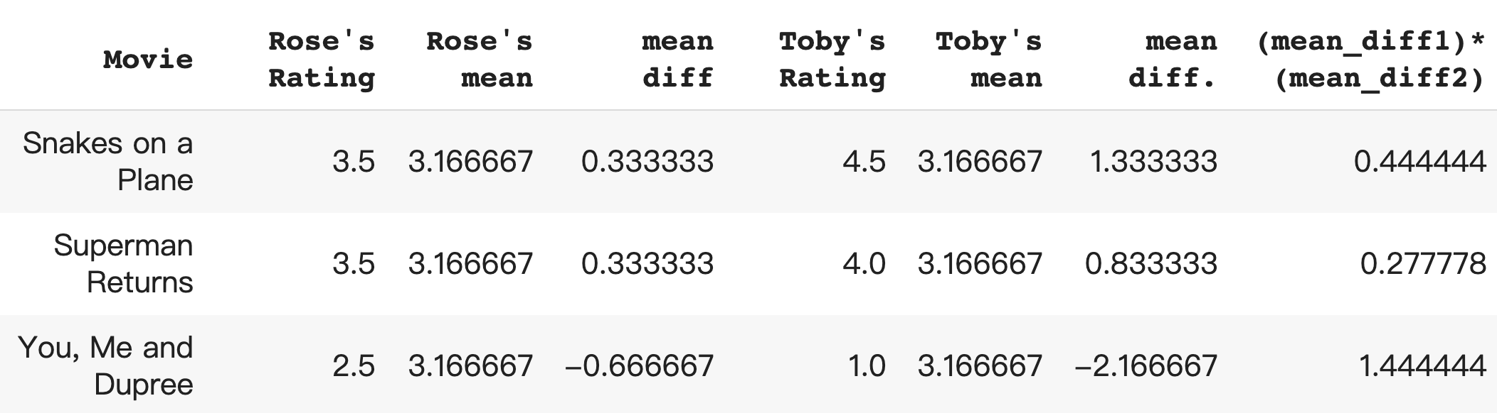
Running Example
r=0.99

Slide 40
Algorithm: Find similar users and use their ratings to predict rating for a target

Slide 41
Alternative: Item-Similarity (1/2)
Item-Based Nearest Neighbor
Generate predictions based on similarities between items.
Prediction for a user u and item i is composed of a weighted sum of the user u’s ratings for items most similar to i.
Item similarity
User similarity

Slide 42
Alternative: Item-Similarity (2/2)
Item Similarity
User Similarity
 | Lady in the Water | Snakes on a Plane | Just My Luck | Superman Returns | You, Me and Dupree | The Night Listener
Rose | 2.5 | 3.5 | 3.0 | 3.5 | 2.5 | 3.0
Seymour | 3.0 | 3.5 | 1.5 | 5 | 3.5 | 3.0
Phillips | 2.5 | 3.0 |  | 3.5 |  | 4.0
Puig |  | 3.5 | 3.0 | 4.0 | 2.5 | 4.5
LaSalle | 3.0 | 4.0 | 2.0 | 3.0 | 2.0 | 3.0
Matthews | 3.0 | 4.0 |  | 5.0 | 3.5 | 3.0
Toby |  | 4.5 |  | 4.0 | 1.0
?
?
?

Slide 43
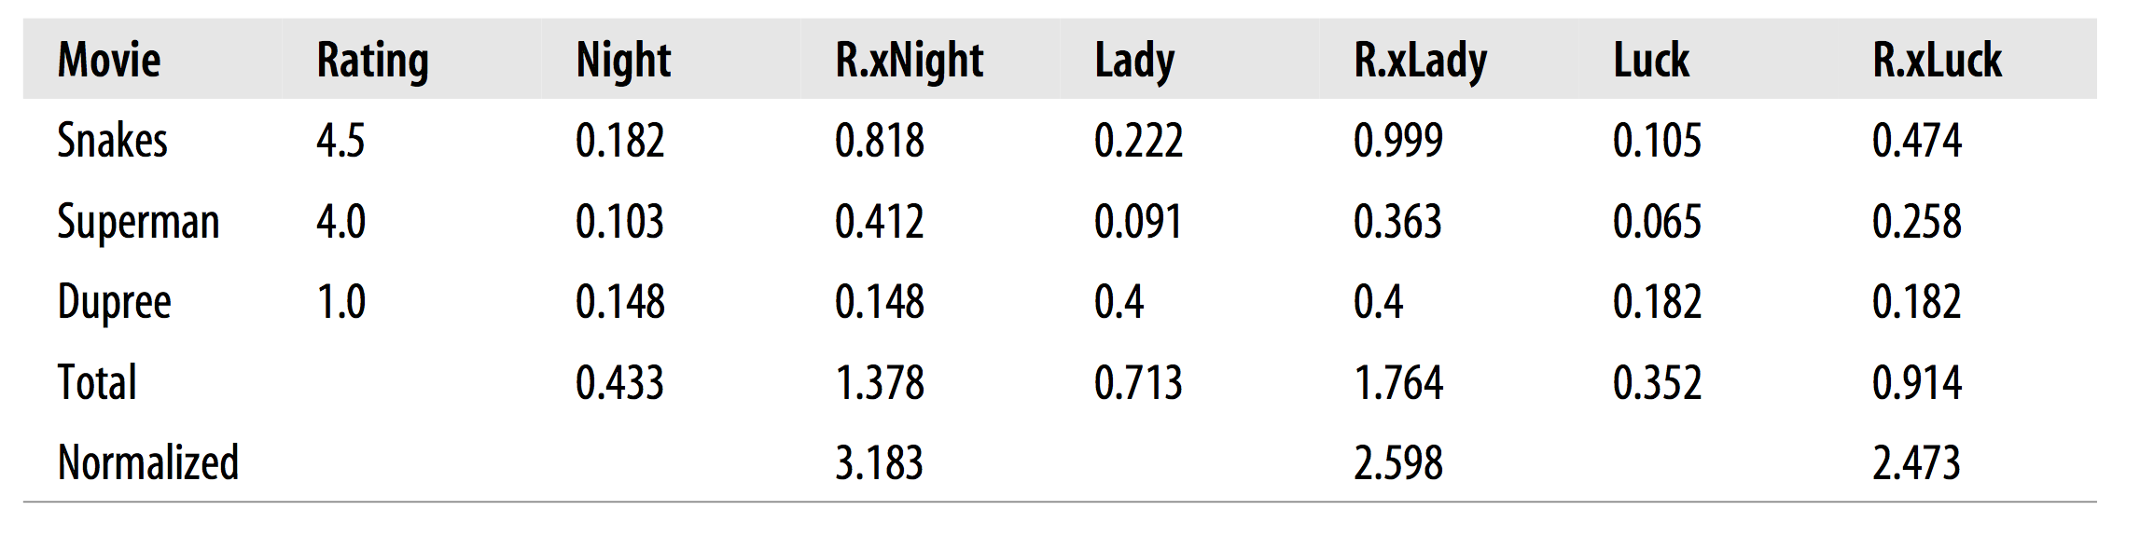
Find the items that a use rated and use (1) the ratings and (2) the item similarity to predict the ratings of new items
The Night Listener’s Prediction for Toby ~=
f(sim(snakes,night), sim(superman,night), sim(Dupree, night))

Slide 44
Efficient Memory Search

Slide 45
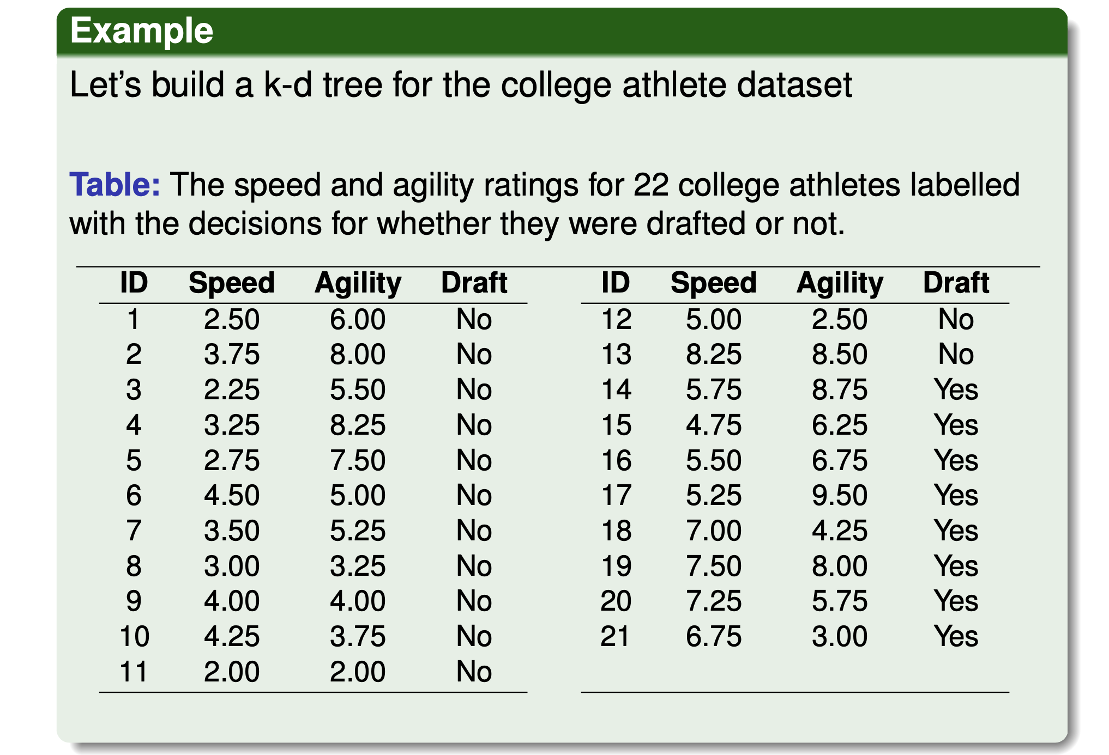
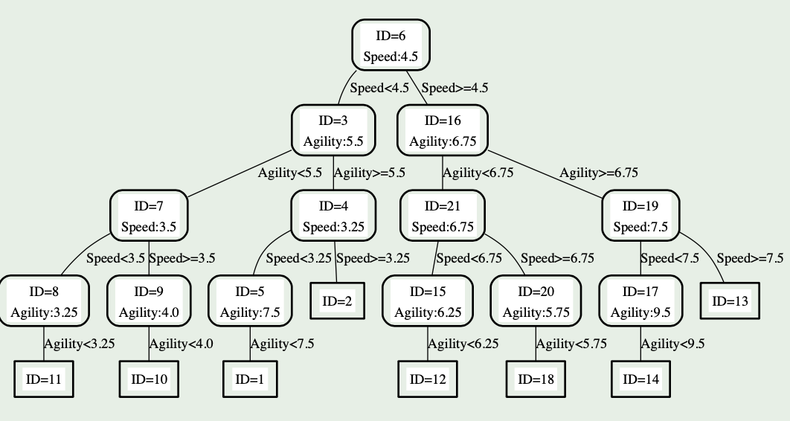
KD Tree
A binary search tree where every node is a k-dimensional point.
Every node (except leaves) represents a hyperplane that divides the space into two parts.
Points to the left (right) of this hyperplane represent the left (right) sub-tree of that node.

Slide 46
KD Tree: Construction
As we move down the tree, we divide the space along alternating (but not always) axis-aligned hyperplanes:
Split by x-coordinate: split by a vertical line that has (ideally) half the points left or on, and half right.
Split by y-coordinate: split by a horizontal line that has (ideally) half the points below or on and half above.

Slide 47
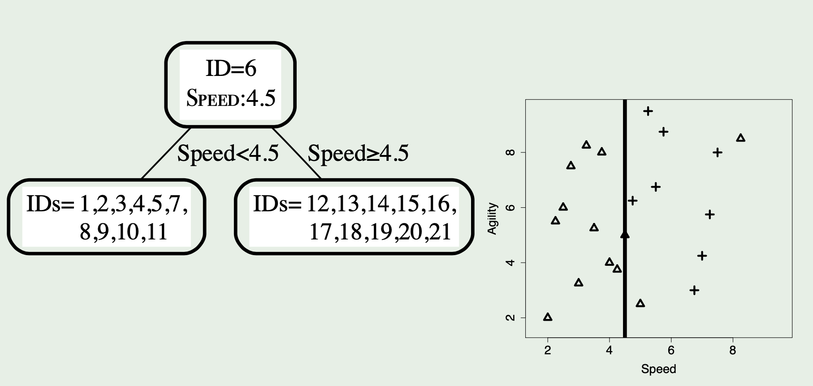
KD Tree: Construction
A binary search tree where every node is a k-dimensional point.
Every node (except leaves) represents a hyperplane that divides the space into two parts.
Points to the left (right) of this hyperplane represent the left (right) sub-tree of that node.

Slide 48
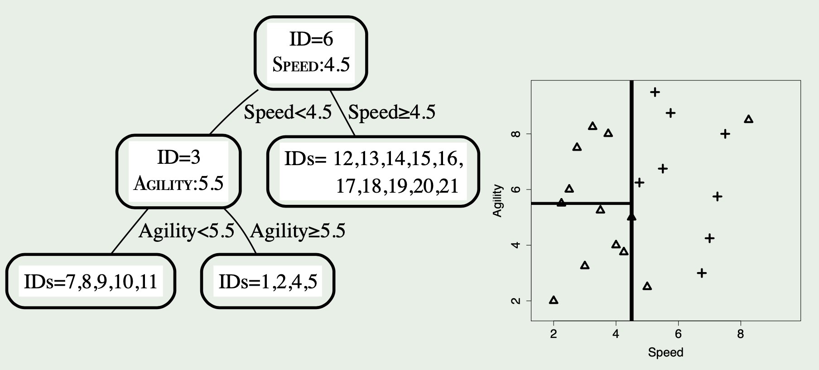
KD Tree: Construction
Second Split

Slide 49
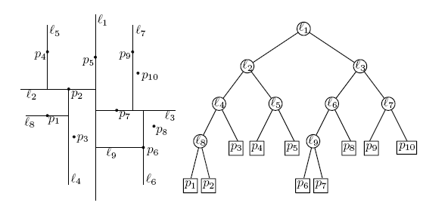
KD Tree - Example
Split by x-coordinate: split by a vertical line that has approximately half the points left or on, and half right.
x

Slide 50
KD Tree - Example
Split by y-coordinate: split by a horizontal line that has half the points below or on and half above.
x
y
y

Slide 51
KD Tree - Example
Split by x-coordinate: split by a vertical line that has half the points left or on, and half right.
x
y
y
x
x
x
x

Slide 52
KD Tree - Example
Split by y-coordinate: split by a horizontal line that has half the points below or on and half above.
x
y
y
x
x
x
x
y
y

Slide 53
Nearest Neighbor with KD Trees
Traverse the tree, looking for the rectangle that contains the query.

Slide 54
Nearest Neighbor with KD Trees
Explore the branch of the tree that is closest to the query point first.

Slide 55
Nearest Neighbor with KD Trees
Explore the branch of the tree that is closest to the query point first.

Slide 56
Nearest Neighbor with KD Trees
When we reach a leaf, compute the distance to each point in the node.

Slide 57
Nearest Neighbor with KD Trees
When we reach a leaf, compute the distance to each point in the node.

Slide 58
Nearest Neighbor with KD Trees
Then, backtrack and try the other branch at each node visited.

Slide 59
Nearest Neighbor with KD Trees
Each time a new closest node is found, we can update the distance bounds.

Slide 60
Nearest Neighbor with KD Trees
Each time a new closest node is found, we can update the distance bounds.

Slide 61
Nearest Neighbor with KD Trees
Using the distance bounds and the bounds of the data below each node, we can prune parts of the tree that could NOT include the nearest neighbor.

Slide 62
Nearest Neighbor with KD Trees
Using the distance bounds and the bounds of the data below each node, we can prune parts of the tree that could NOT include the nearest neighbor.

Slide 63
Nearest Neighbor with KD Trees
Using the distance bounds and the bounds of the data below each node, we can prune parts of the tree that could NOT include the nearest neighbor.

Slide 64
K-Nearest Neighbor Search
Can find the k-nearest neighbors to a query by maintaining the k current bests instead of just one.
Branches are only eliminated when they can't have points closer than any of the k current bests.

Slide 65
NN example using kD trees
d=1 (binary search tree)
5
20
7
8
10
12
13
15
18
7,8,10,12
13,15,18
7,8
10,12
13,15
18
7, 8
10, 12
13, 15
18

Slide 66
NN example using kD trees (cont’d)
d=1 (binary search tree)
5
20
7
8
10
12
13
15
18
query
7,8,10,12
13,15,18
17
7,8
10,12
13,15
18
min dist = 1
7, 8
10, 12
13, 15
18

Slide 67
NN example using kD trees (cont’d)
d=1 (binary search tree)
5
20
7
8
10
12
13
15
18
query
7,8,10,12
13,15,18
16
7,8
10,12
13,15
18
min dist = 2
min dist = 1
7, 8
10, 12
13, 15
18

